Slide 1


Anton Rechenauer
May 28th 2022

Slide 2

Outline
Executive Summary
Introduction
Methodology
Results
Conclusion
Appendix

Slide 3
Executive Summary
Summary of methodologies
Data Collection classical style (CSV files)
Data Collection using web scraping (from Wikipedia)
Data Wrangling and Cleaning
Exploring the data - SQL, Visualizations, GIS(Folium)
Building an interactive dashboard
Prediction (here: Classification) using Machine Learning
Summary of all results
Data Analysis results: success is more likely for light payload
Discussion of the quality of the predictions from ML – we can achieve an accuracy of more than 80%

Slide 4
Introduction
Project background and context: SpaceX made payload transport to an orbit cheap – they can reuse the first stage (aka “Stage One”) of their rocket Falcon9. This cuts down the cost from $165m to $62m per launch! But there are still a lot of unsuccessful attempts to recover the first stage!
This raises an obvious question: Can we find out the conditions or parameters for a successful recovery of Stage One? Is there a – explainable - reason why it sometimes fails?
A first baby step is to check whether we can predict success/failure!

Slide 5

Section 1

Slide 6
Methodology
Executive Summary
Data collection methodology:
Collect rocket launch data via REST-API from SpaceX, get data from web scraping on Wikipedia
Perform data wrangling
Modify and add Columns, remove outliers, discuss missing data, One-Hot Encoding etc.
Perform exploratory data analysis (EDA) using visualization and SQL
Perform interactive visual analytics using Folium and an interactive dashboard
Perform predictive analysis using classification models
We do the usual Test/Train split and then train several classification models to predict success or failure of recovery.
For each model the best hyperparameters are found using cross-validation
We finally compare the accuracy of these models using test data

Slide 7
Data Collection
Data Collection “SpaceX” SpaceX provides a REST-API where several JSON-files (data about the rockets, payloads, launchpad, cores) files could be downloaded. These where combined, filtered for the falcon9 data and then exported in csv format.
Data Collection “Wikipedia” Python libraries were used to retrieve the HTML of a relevant webpage (as text) and the launch related data was extracted using the famous library htmlsoup.

Slide 8
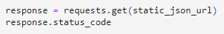
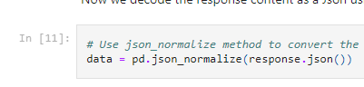
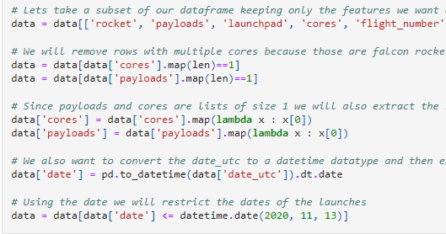
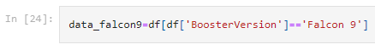
Data Collection – SpaceX API
GitHub Link https://github.com/Bleiglanz/Capstone_SpaceX/blob/main/jupyter-labs-spacex-data-collection-api.ipynb
get JSON from server
Normalize and convert to dataframe
Transform and combine to final dataframe
filter and export csv

Slide 9
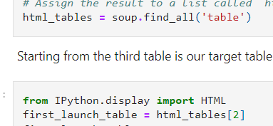
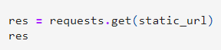
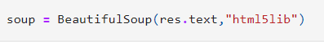
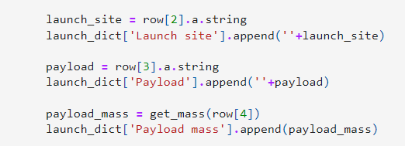
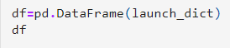
Data Collection – Web Scraping from Wikipedia
GitHub https://github.com/Bleiglanz/Capstone_SpaceX/blob/main/jupyter-labs-webscraping.ipynb
get HTML text
soupify
Get tables and columns
Build a dictionary from columns
Transform
Dictionary to dataframe
Export to csv

Slide 10
Data Wrangling
Exploratory Data Analysis (EDA) is the process of cleaning, unifying and understanding complex data.
The goal is insight into the data, it’s structure and discovery possible problems.
In this project:
Find number of launches at each site
Find the orbit for each launch
Work out the success rates (Labels)
GitHub https://github.com/Bleiglanz/Capstone_SpaceX/blob/main/labs-jupyter-spacex-Data-wrangling.ipynb

Slide 11
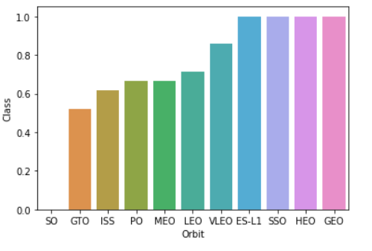
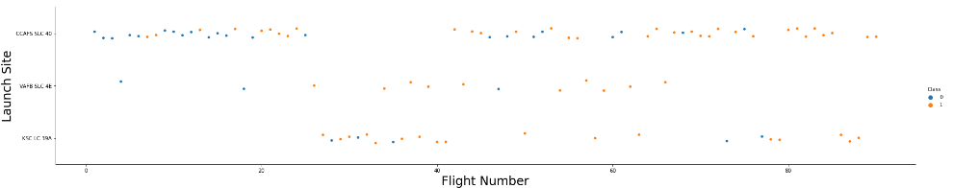
EDA with Data Visualization
GitHub: https://github.com/Bleiglanz/Capstone_SpaceX/blob/main/jupyter-labs-eda-dataviz.ipynb
Examples: flight vs. launch site, success vs. orbit
The following scatter plots were created:
Payload Mass / Flight Number Launch Site / Flight Number Launch Site / Payload Mass Orbit / Flight Number, Playload / Orbit
In addition, we created a bar graph (Success Rate / Orbit) and a Line Graph (Success Rate / Year)

Slide 12
EDA with SQL: We performed several queries
GITHUB https://github.com/Bleiglanz/Capstone_SpaceX/blob/main/jupyter-labs-eda-sql-coursera.ipynb
Names of unique launch sites
Five records where launch sites begin with CCA
Total payload mass carried by boosters launched by NASA (CRS)
Average payload mass carried by booster F9 v1.1.
Date of first successful landing outcome in ground pad
Name of boosters successfully recovered in drone ship and have payload mass >= 4000 and <= 6000.
Count of successful and failure mission outcomes.
Names of the Boosters of maximum payload mass.
List the records which will display the month names, failures in drone ship, booster versions in 2015.
Rank successful landing between the date 04-06-2010 and 20-03-2017 in descending order.
Hint to grader: My Watson account was blocked, I used sqlite!

Slide 13
Interactive Map with Folium
GitHub https://github.com/Bleiglanz/Capstone_SpaceX/blob/main/lab_jupyter_launch_site_location_folium.ipynb
We used Folium to add Markers, Circles and Lines to an interactive map showing the launch sites of the Falcon9 rocket
Markers indicate points (here: launch sites) and the frequency of launches at each site (green=successful recovery of Stage One for this launch, red=failure of recovery)
Circles were used to highlight areas
Lines were used to indicate distances (closest proximity to coastline, city, railway etc)

Slide 14
Dashboard with Plotly Dash
GitHub https://github.com/Bleiglanz/Capstone_SpaceX/blob/main/dashboard/spacex_dash_app.py
The dashboard contains to graphs: A pie chart showing the total number of launches by a site (or all of them combined). For a selected launch site, the pie chart showed a breakdown of launches (successful/failures) A scatter plot of the outcome (successful recovery of Stage One or not) versus the payload mass. The bound of the mass can be interactively changed by the user.

Slide 15
Predictive Analysis (Classification)
GitHub https://github.com/Bleiglanz/Capstone_SpaceX/blob/main/SpaceX_Machine%20Learning%20Prediction_Part_5_Prediction.ipynb
Model Development was done using the standard ML approach
In the Lab we used scikitlearn GridSearchCV find the best hyperparameters for a variety of models (Logistic Regression, SVM, Decision Tree, KNN). For every model the confusion matrix was created, and we compared the models using a simple score (accuracy). Since the dataset was very small and not to skewed this seems ok. In a future analysis the F1-score should be used!!
Hyperparameter Tuning and Model Selection
Test/Train split
Model Training
Evaluation

Slide 16
Results
From EDA we see that more recent starts have a better chance of successful booster recovery (obviously SpaceX learned how to do it better in the course of time)
There is a baseline of about 80% success (SpaceX has already achieved this)
Unsuccessful launches are in the past!
One site stands out: KSC LC-39A has a success rate of 75%
We suggest to look at drone ships: using these increases the chances of a successful recovery of the Stage One!
It is possible to predict the results with a accuracy of 83%. But this means almost nothing – the dataset is very, very small and a bit skewed.
It is a small dataset, results a confounded by the technological progress SpaceX has made in the past few years. But let’s look at the details:

Slide 17

Section 2

Slide 18
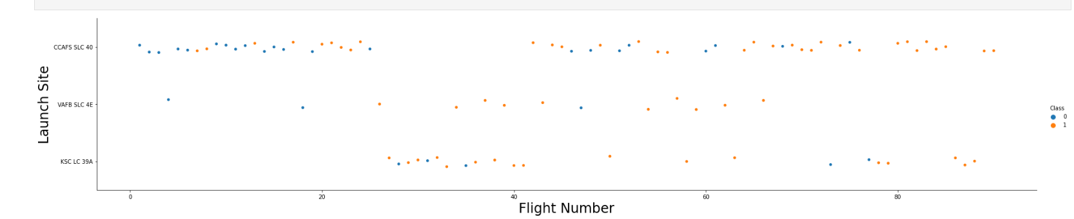
Flight Number vs. Launch Site
We see more and more orange=successful recoveries in the course of time (higher flight number).
This means that at every site the situation gets better, chances of success are increasing!

Slide 19
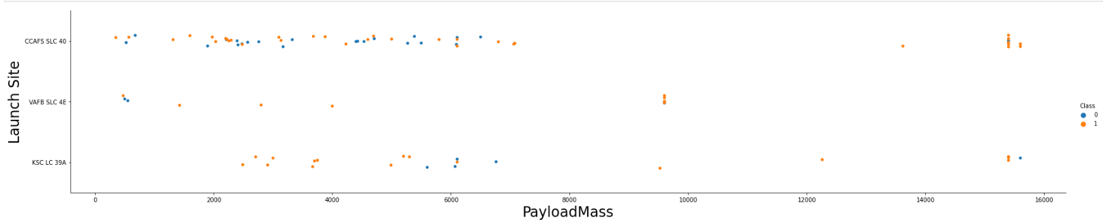
Payload vs. Launch Site
The highest chance of a successful recovery is a mid-range or high payload.
But this effect isn’t very convincing.

Slide 20
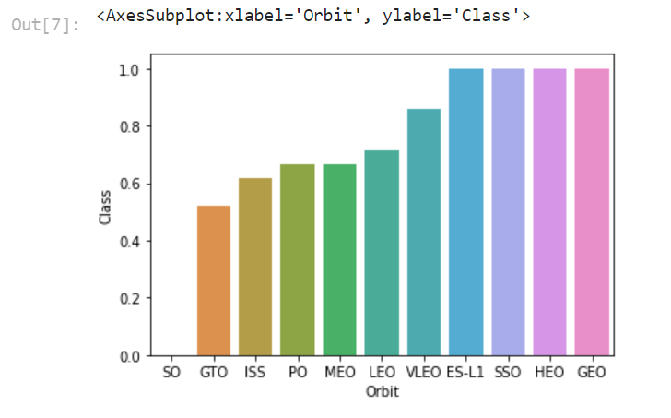
Success Rate vs. Orbit Type
It seems obvious that some orbits are perfect for success (100% recovery rate). But GEO has only one launch – be careful here, use absolute numbers to be sure!
This chart is not an explanation of success/failure in the whole dataset. The successful orbits are the ones tried later in time (after SpaceX learned how to do it)
Nethertheless the orbit (height, involved velocity etc.) could affect the success rate very much.

Slide 21
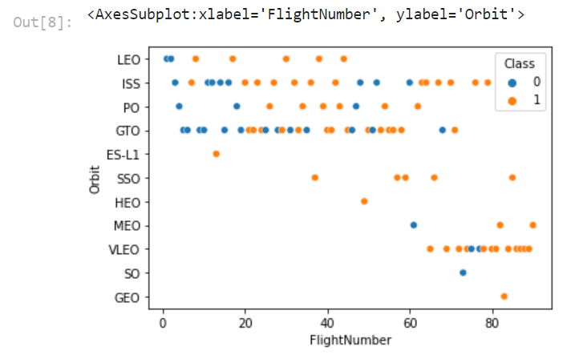
Flight Number vs. Orbit Type
This chart should be compared to the previous one
Not every orbit was in the program in the past!
The GEO orbit is possbly an outlier (maybe it should be removed from the dataset)

Slide 22
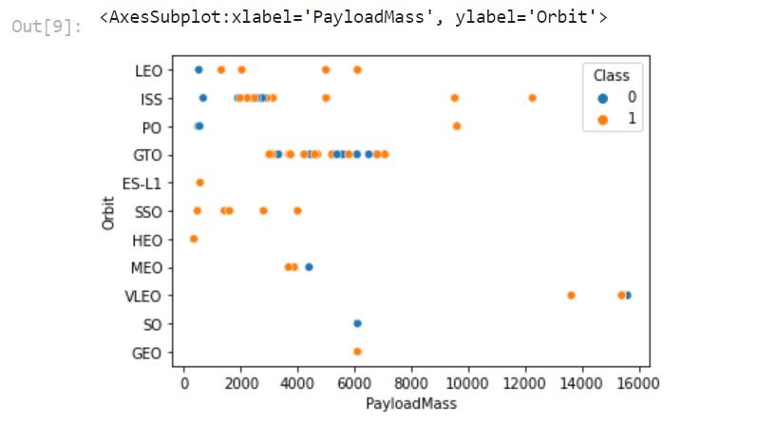
Payload vs. Orbit Type
There is no relevant relation between orbit type and payload
GTO has a narrow, continuous range of payloads, ISS a wide one
We see GEO and SO as possible outliers again

Slide 23
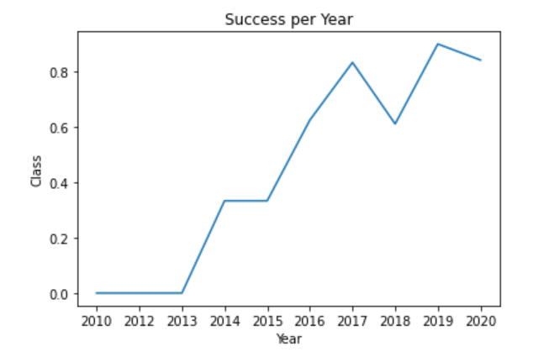
Launch Success Yearly Trend
The success rate is increasing over the years
SpaceX has achieved almost 80% success rate now (so the accuracy of our prediction from the ML model is questionable)

Slide 24
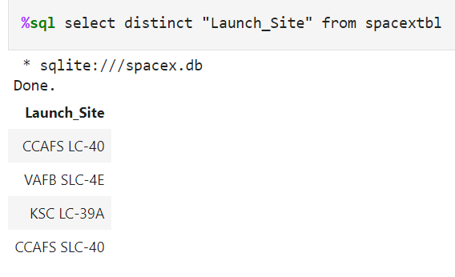
All Launch Site Names
Find the names of the unique launch sites:
“distinct” removes duplicates from the resultset.

Slide 25
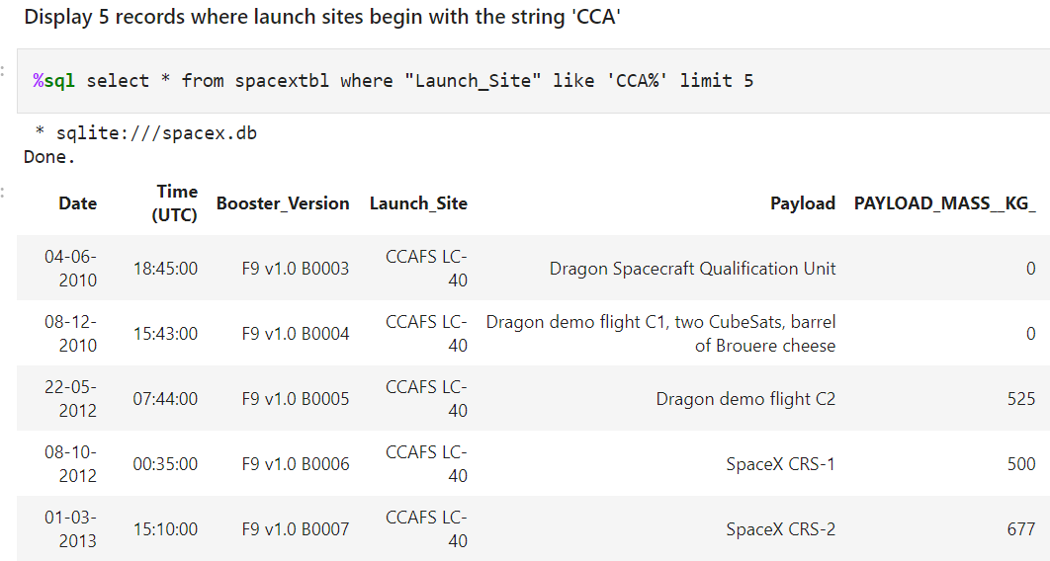
Launch Site Names Begin with 'CCA'
The clause like ‘pattern%’ finds all string beginning with pattern
Limit 5 displays only the first five rows
result is not reproducible, since there might be more than five rows (and the resultset is unordered!)

Slide 26
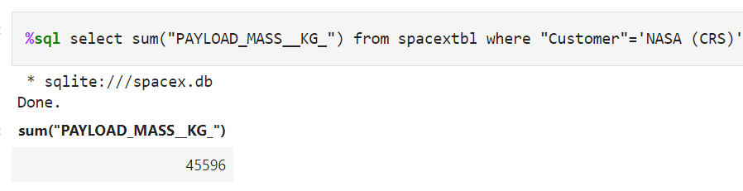
Total Payload Mass
Calculate the total payload carried by boosters from NASA
Ambiguous formulation: “from NASA” – there is only one customer like NASA

Slide 27
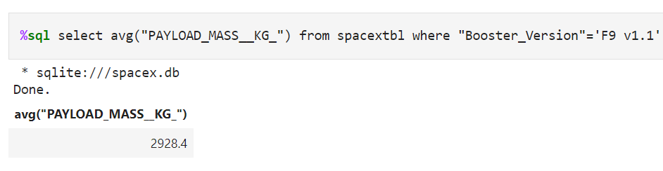
Average Payload Mass by F9 v1.1
Calculate the average payload mass carried by booster version F9 v1.1
Simple query using a aggregation function in sql, in this case AVG
The where clause filters exactly in this case

Slide 28
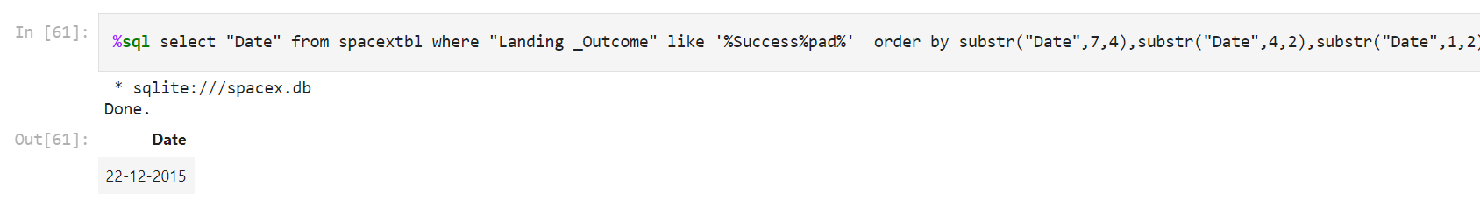
First Successful Ground Landing Date
Find the dates of the first successful landing outcome
This was more complicated in sqlite, because of weak date and time functionality
In DB2 one would use something simple: SELECT MIN(DATE) FROM SPACETBL WHERE LANDING_OUTCOME LIKE ‘%Success%pad%’

Slide 29
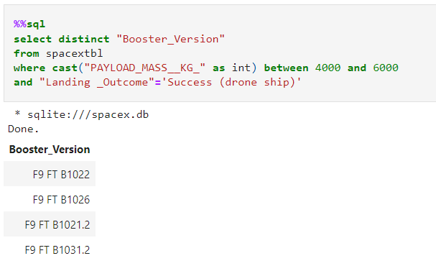
Successful Drone Ship Landing with Payload between 4000 and 6000
List the names of boosters which have successfully landed on drone ship and had payload mass greater than 4000 but less than 6000
Simple sql query using BETWEEN, also the question requires a DISTINCT

Slide 30
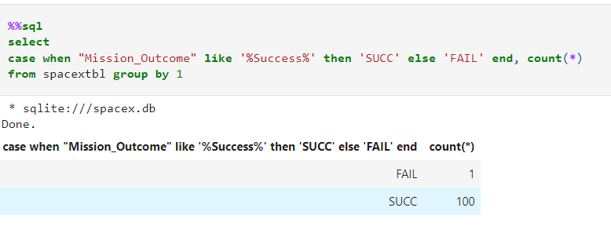
Total Number of Successful and Failure Mission Outcomes
Calculate the total number of successful and failure mission outcomes
Success should be a Boolean field in the database, it is just bad practice to use like patterns

Slide 31
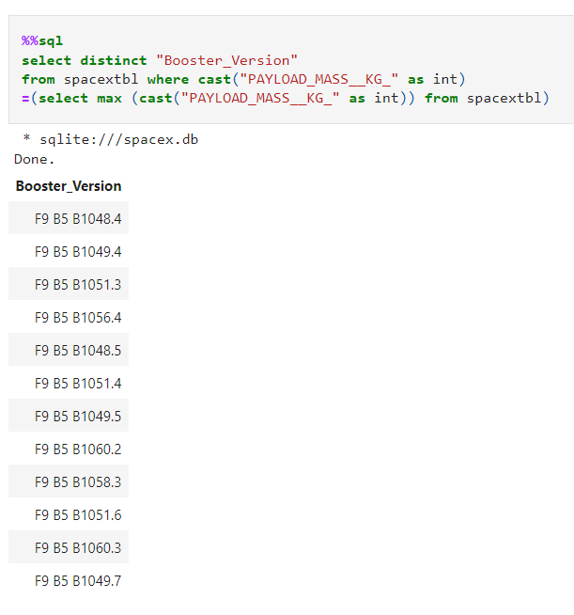
Boosters Carried Maximum Payload
List the names of the booster which have carried the maximum payload mass
One has to use a subquery
First find the maximum payload
Return this value from the subquery and use it in a where clause
Since the same Booster could be used in several launches => DISTINCT is required

Slide 32
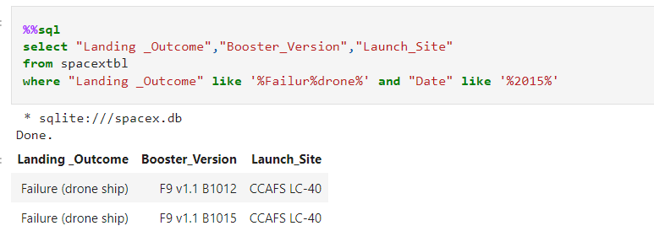
2015 Launch Records
List the failed landing_outcomes in drone ship, their booster versions, and launch site names for in year 2015
In DB2 one should use YEAR(Date)=2015 of course

Slide 33
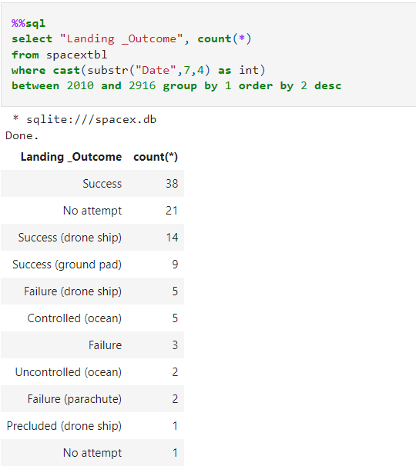
Rank Landing Outcomes Between 2010-06-04 and 2017-03-20
Rank the count of landing outcomes (such as Failure (drone ship) or Success (ground pad)) between the date 2010-06-04 and 2017-03-20, in descending order
This is hard to do in sqlite
In DB2 it is easy, just the same query but with a better condition in the where clause:
“DATE” >= ’04-06-2010’ AND DATE<=‘20-03-2017’

Slide 34

Section 3

Slide 35
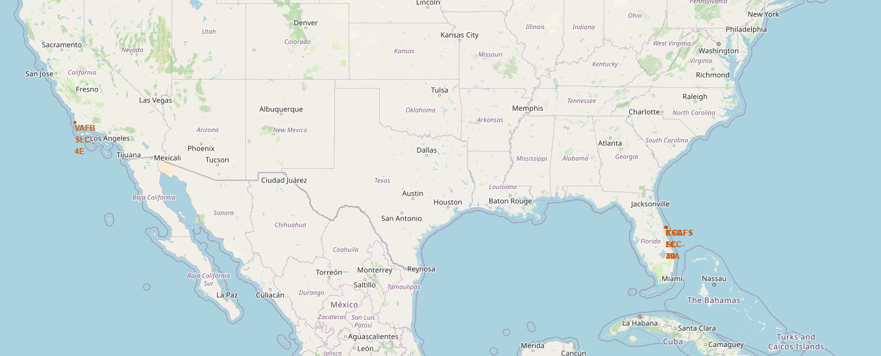
All Launch Sites of SpaceX
Just showing the launch sites on a map of the USA

Slide 36
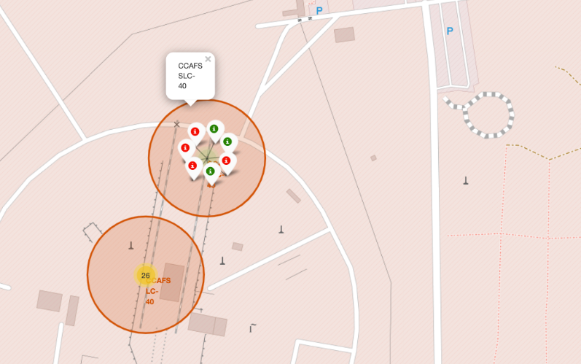
Icons and Markers – Launches
Each marker shows a launch.
The color coding for the markers is
Green = Success, Booster recovered
Red = Failure, Booster not recovered

Slide 37
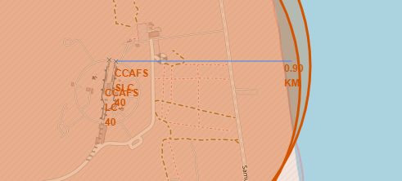
Distances
Lines can be used to show distances
For example:
How close is the launch site to the coastline?

Slide 38

Section 4

Slide 39
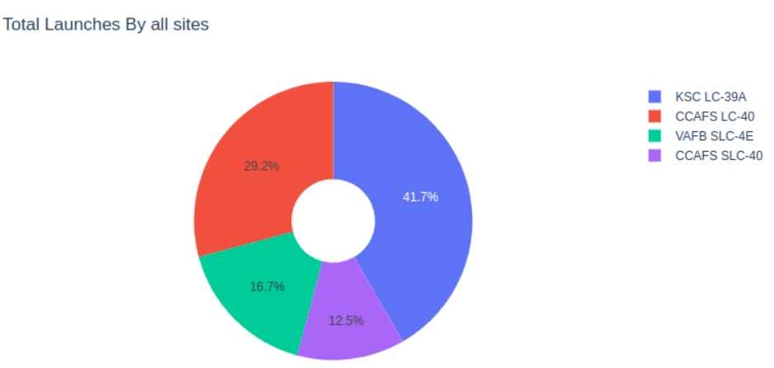
Pie Chart – Success percentage per Site
KSC has the highest success rate for all sites

Slide 40
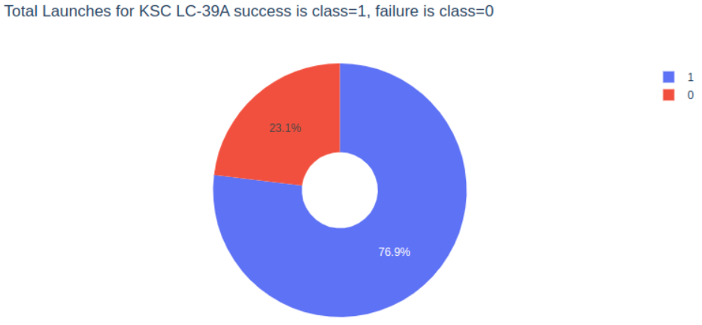
Pie Chart – Launch Site with highest launch success ratio
Selecting a site shows the distribution of failures/success for each site
KSC has the highest percentage of successful recoveries of Stage One Booster

Slide 41
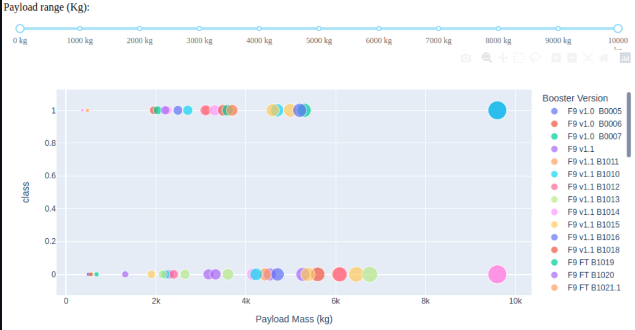
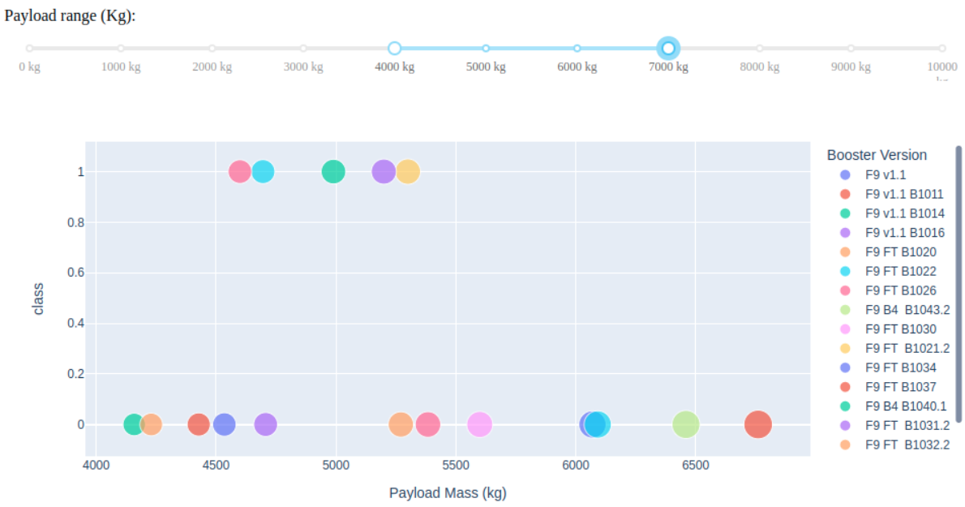
Scatterplot of payload vs launch site
A slider in the interactive dashboard allows the user to restrict the payloads
LEFT: payload/success for all payload ranges
RIGHT: payload/success only for payloads between 4000 kg and 7000 kg

Slide 42

Section 5

Slide 43
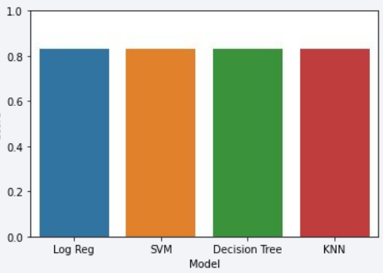
Classification Accuracy
For models were created, and the accuracy on the test data was computed:
LogReg 83.3%
SVM 83.3%
Tree 83.3%
KNN 83.3%
On the validation set the scores were different, but this does not play any role.

Slide 44
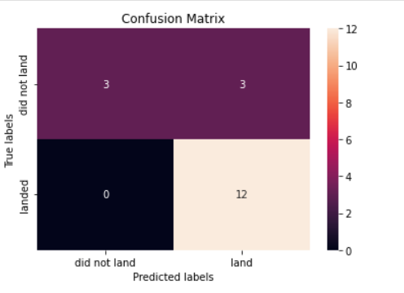
Confusion Matrix
All models had the same confusion matrix on the test data!
As the dataset was extremely small, the test-set was super small (only 18 rows)
The only problem were false positives, but only three cases

Slide 45
Conclusions
We simply did not have enough data Doing ML on 90 records probably creates more confusion than real insight.
Since SpaceX had already achieved a success rate for Booster recovery of over 80% in 2017, our ML models and predictions (83% accuracy!) are not impressive
But if we take the data seriously, we could provide some hints:
KSC site is very successful
Launches with a payload above 7000kg might be less risky
Some orbits are better than others, this should be investigated

Slide 46


